Slide 1
Chapter 2

Slide 2
Rigid Body Physics
Rigid body?
Shape does not change during/after events
Does not work
Jello
Liquid
Fire
Dropping wood block on the floor

Slide 3
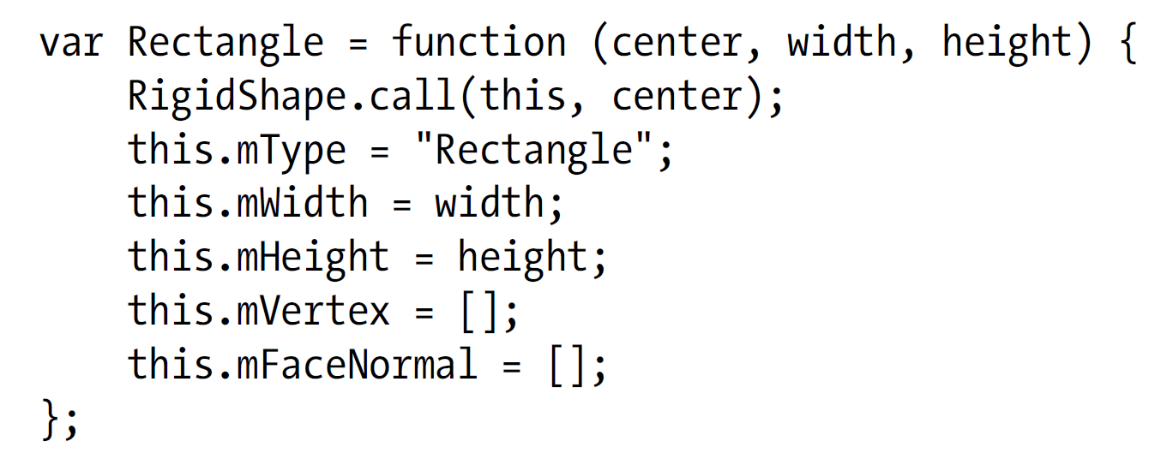

Slide 4
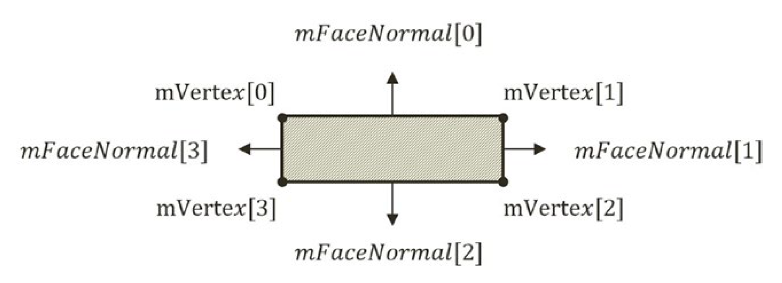

Slide 5
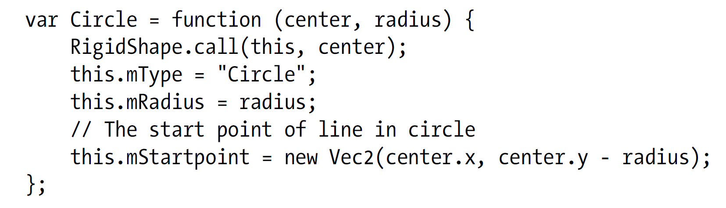
To support showing of rotation

